Slide 1
Data Quality Controls Scorecard
Author: Somanatha Moharana
Contact: 9938016965

Slide 2
Problem Statement
Develop KPIs for data quality by defining your own configurable rules, controls and definitions. Furthermore, to perform an analysis on the connected data source based on the standard rules defined to generate a data quality and data accuracy score, on daily basis on incremental data.
This score helps the business owner to make a rational decision to either use the data as it is or reject the data to bring its quality to the desired level.

Slide 3
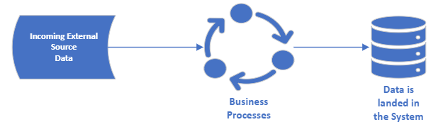
Current/Existing System
Existing Process flow happens the usual way wherein Data comes in & goes out after some business transformations have been applied without any Sanity layer in between to understand the quality of data.

Slide 4
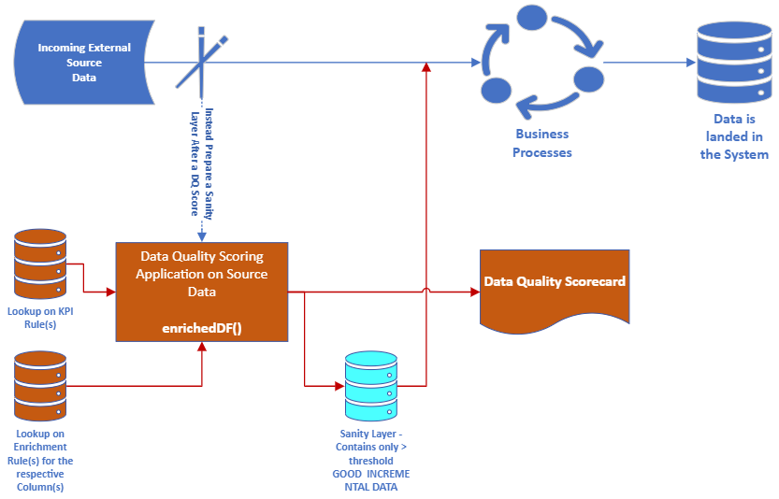
Proposed System
Proposed model wherein a Sanity layer is introduced in between that controls/understands the quality of data received.

Slide 5
KPIs for DQ Scorecarding – Library created that comprises of Luhn Algorithm to help PAI compliance check + Custom made algorithms to validate all the 6 Attributes of Data Quality Controls
All below checks will help understand the Anomalous levels of data :-
1. Data Completeness : check around if all critical fields in a record be fully populated
1.a. COMPLETENESS Check
2. Data Standardization : Validates how well data conforms to standards
2.a. DATATYPE Check
2.b. LENGTH Check
3. Data Accuracy : Segregate on below levels -
3.a. BLANK/NULL Check
3.b. ALPHANUM Check
3.c. NUMERIC Check
3.d. ALPHA Check
3.e. PAI COMPLIANCE Check – Luhn Algorithm to validate whether or not it’s a legitimate PAI value flowing in
4. Data Consistency : Consistency measures how individual data points pulled from two or more sets of data synchronize with one another. If two data points are in conflict, it indicates that one of both of the records are inaccurate.
e.g., If the two sources have different phone numbers for the same customer, the data is inconsistent.
4.a. CONSISTENCY Check i.e., to validate for a group of Source System UPI column(s) combined for the respective column, it populates always the similar value
5. Data Currency : It is a metric that measures the age of data in a database. More current data are likely to be more accurate and relevant, as information – especially customer information – can change over time. Timeliness is tracked via timestamps on the data sources. Establish a base difference between the current date and then either reverify, update, or archive older data.
5.a. TIMELINESS Check i.e., Check if data has recently come in per threshold configured say in last 15 days
5.b. CURRENT DELTA Check i.e., check if from the last time to the recent if the data has undergone a change
6. Data Uniqueness : The uniqueness metric tracks duplicate data. We don’t want to Calculate any data record twice, as that can unduly weight any results. It’s important to identify duplicates and Decide either to merge them or delete the duplicates.
6.a. DUPLICATE Check

Slide 6
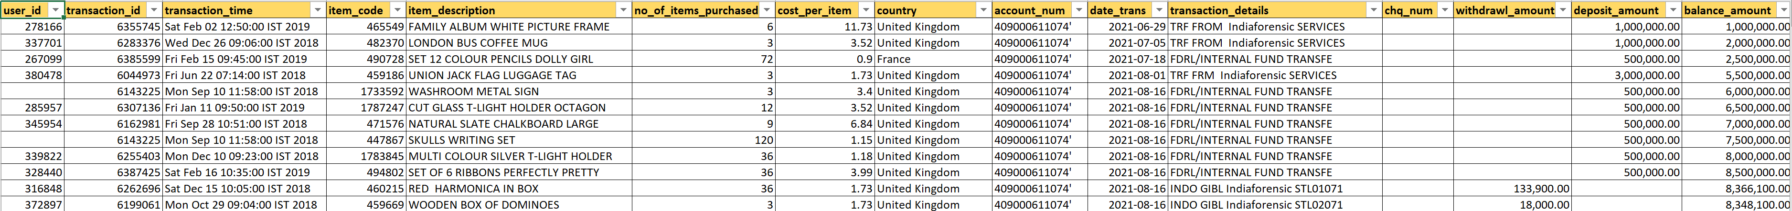
Sample Source Feed
CREATE EXTERNAL TABLE src_bank_transaction_data(
user_id bigint,
transaction_id bigint,
transaction_time string,
item_code bigint,
item_description string,
no_of_items_purchased bigint,
cost_per_item decimal(19,2),
country string,
account_num string,
date_trans date,
transaction_details string,
chq_num bigint,
withdrawl_amount decimal(19,2),
deposit_amount decimal(19,2),
balance_amount decimal(19,2))
COMMENT 'Contains Bank Transaction data'
ROW FORMAT DELIMITED FIELDS TERMINATED BY ','
STORED AS TEXTFILE
LOCATION 'hdfs://nameservicecrtocc/projects/ccdri/hive/cdsltacert/src_bank_transaction_data'
tblproperties ("skip.header.line.count"="2");

Slide 7
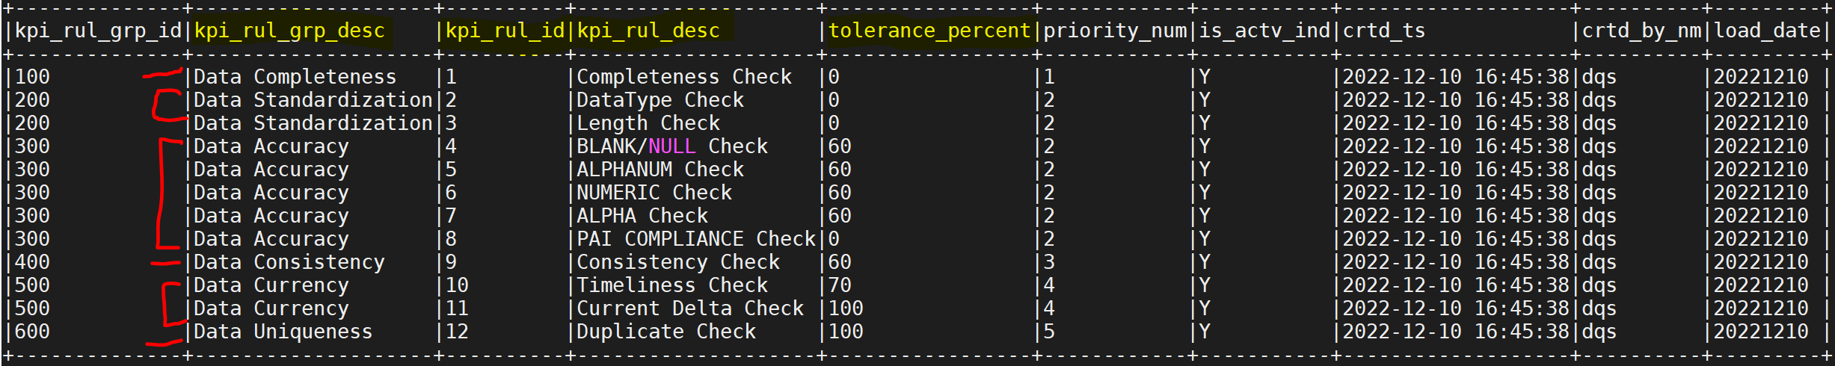
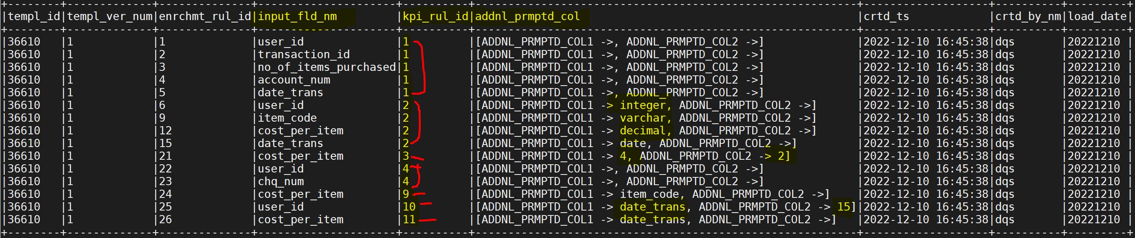
KPI Metrics Captured in : cds_dq_scorecard_kpi
All KPI Rules are captured in the table – “cds_dq_scorecard_kpi” that entails all metadata around tolerance percentage and priority order of Rule(s) to be applied to each Column(s) :-
KPI Metrics Applied at each Column level in : cds_dq_scorecard_enrichment
This table consists of all above KPI rule(s) applied to column(s) of incoming data feed. As shown, we can have a particular Template ID defined per each Source system sending the data feed and corresponding rule(s) defined :- **ADDNL_PRMPTD_COL = holds parameters/arguments passed for the Rule when required & is made Dynamic Map that can accommodate any number of parameters that is scaled up

Slide 8
How to Run the Component ?
SPARK SUBMIT
spark2-submit --master yarn-client --driver-class-path '/opt/cloudera/parcels/CDH/lib/hive/lib/*' --conf 'spark.executor.extraClassPath=/opt/cloudera/parcels/CDH/lib/hive/lib/*' --driver-memory 4G --jars /oprapp/prod/gpfs/oprappcert/cdscert/ccdri/Datathon/javalib/ccdri/jaxrpc.jar,/oprapp/prod/gpfs/oprappcert/cdscert/ccdri/Datathon/javalib/ccdri/commons-discovery.jar,/oprapp/prod/gpfs/oprappcert/cdscert/ccdri/Datathon/sparklib/ccdri/PostprocessUDF.jar,/oprapp/prod/gpfs/oprappcert/cdscert/ccdri/Datathon/javalib/ccdri/db2jcc4.jar,/oprapp/prod/gpfs/oprappcert/cdscert/ccdri/Datathon/javalib/ccdri/ibmjcefw.jar,/oprapp/prod/gpfs/oprappcert/cdscert/ccdri/Datathon/javalib/ccdri/ibmjceprovider.jar,/oprapp/prod/gpfs/oprappcert/cdscert/ccdri/Datathon/javalib/ccdri/ibmpkcs.jar,/oprapp/prod/gpfs/oprappcert/cdscert/ccdri/Datathon/javalib/ccdri/log4j-1.2.7.jar,/oprapp/prod/gpfs/oprappcert/cdscert/ccdri/Datathon/javalib/ccdri/CCDRiNGCommonTools.jar,/oprapp/prod/gpfs/oprappcert/cdscert/ccdri/Datathon/javalib/ccdri/ccdr-commons.jar --properties-file /oprapp/prod/gpfs/oprappcert/cdscert/ccdri/Datathon/Config/ccdri/dqscorecardprops.properties --conf spark.outbound.env=CERT-H --conf spark.storage.memoryFraction=1 --conf spark.kryoserializer.buffer.max=512m --conf spark.network.timeout=1200 --conf spark.sql.broadcastTimeout=1200 --conf spark.executor.heartbeatInterval=1000 --conf spark.driver.maxResultSize=4G --conf spark.sql.shuffle.partitions=100 --conf spark.sql.autoBroadcastJoinThreshold=200000000 --conf spark.executor.instances=10 --executor-cores 4 --executor-memory 6G --conf spark.eventLog.enabled=true --conf spark.eventLog.dir=hdfs:///spark2-history/ --conf spark.yarn.historyServer.address=http://sl55caehmpc806.com:18080/ --class dqs.ccdri.workflow.Main /oprapp/prod/gpfs/oprappcert/cdscert/ccdri/Datathon/sparklib/ccdri/DqScorecard.jar > dqscorecard.log
1. Source Feed Data present in Project repo – docs/bank_transaction_data.csv. For which a table is created as mentioned in – docs/src_bank_transaction_data.hql
2. KPI Metrics metadata table to be created as in Project repo – docs/hive_dml_kpi.hql
3. Enrichment metadata table that contains Column(s) specific DQ rules to be applied is dynamically adjusted from the table itself and to be created & populated as in repo – docs/hive_dml_enrichment.hql
4. Property File is placed under the repo – docs/dqscorecardprops.properties

Slide 9
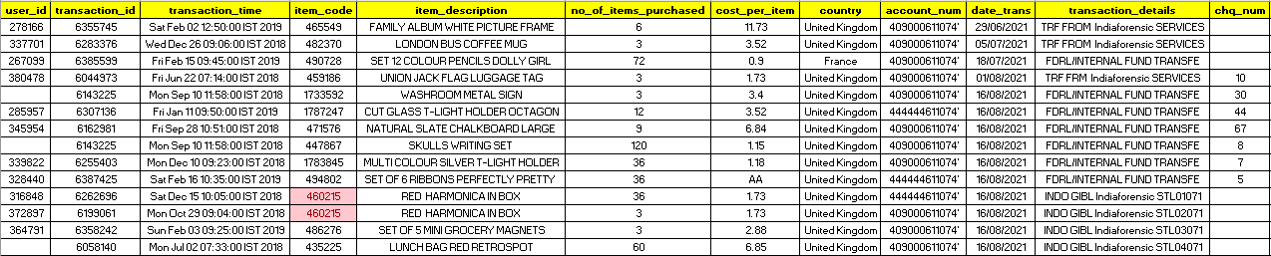
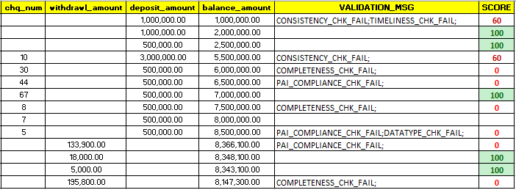
Data Quality Scorecard Generated

